Slide 1

Libro de Arte Coquinaria: annotation campaign and model training on

Slide 2
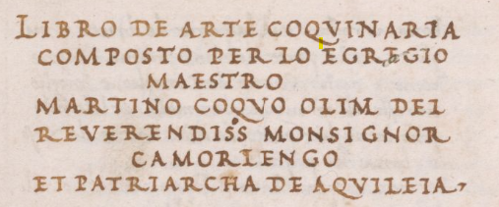
An ancient cookbok.
The Vihelig MS is a 15° century Italian manuscript: it carries a copy of the Libro de arte Coquinaria by Maestro Martino da Como, the «prince of cooks».
Sixty-four, well preserved textual leaves
A professional scribe
The humanist minuscule
Publicly available on the LC website

Slide 3
Annotation campaign
High-quality transcriptions for training our model.

Slide 4
Defining our task
Transcribing twenty-five pages as consistently as possible.
Superscript characters;
Brevigraphs ('&‘);
Tildes (ĩ for ‘in’);
Punctuation marks and whitespaces;
… But what and how to transcribe?
Ligatures, equivalent u/v, long s (ſ), ...
Accents and other diacritics;
Scribal corrections;
Non-standardised forms.

Slide 5
Task 1: normalising the text.
At first, we opted for a slightly normalized transcription.
The goal.
Obtaining a text that could be read and searched both by experts and by the general public.
The methods.
Expanding abbreviations;
Adding accents to ambiguous words;
Normalising whitespaces;
Normalising uppercase;

Slide 6
Pilot 1.
Immagine txt
Immagine txt

Slide 7
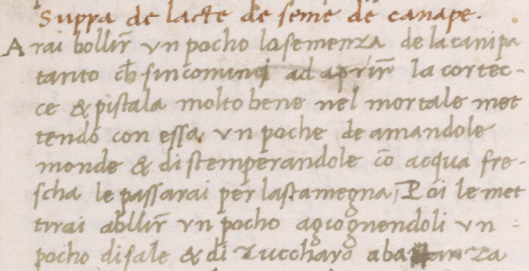
A vague task and its drawbacks:
Low inter- annotator agreement;
Space for personal interpretation;
Concealing the document‘s features;
Conventions and reusability;

Slide 8
Task 2: a faithful reproduction
The transcription should represent the text as faithfully as possible,
retaining its most characterizing features as carried by the document.
The goals.
Minimising transcription errors depending on the annotators’ interpretation;
Follow more closely the Transkribus conventions adopted by several authoritative projects;
Obtain a more robust model that could in principle be reusable, e.g. as a base model for other documents.
The methods.
Our Transcription guidelines.

Slide 9
Inter-annotator agreement.

Slide 10
How to calculate it?
With a Python function cal

Slide 11
First evaluation
 | Ann1 - Ann2 | Ann1 - Ann3 | Ann2 - Ann3
P.3 | 92.7% | 90.1% | 92.3%
P.34 | 87.5% | 87.9% | 90.3%
P.40 | 90.4% | 92.1% | 90.4%

Slide 12
Last evaluation
 | Ann1 - Ann2 | Ann1 - Ann3 | Ann2 - Ann3
P.3 | 97.5% | 97.5% | 99.2%
P.34 | 96.3% | 97.0% | 97.0%
P.40 | 94.1% | 94.1% | 95.6%
Average IAA | 96.0% | 96.2% | 97.3%

Slide 13
Training.

Slide 14
Training.

Slide 15
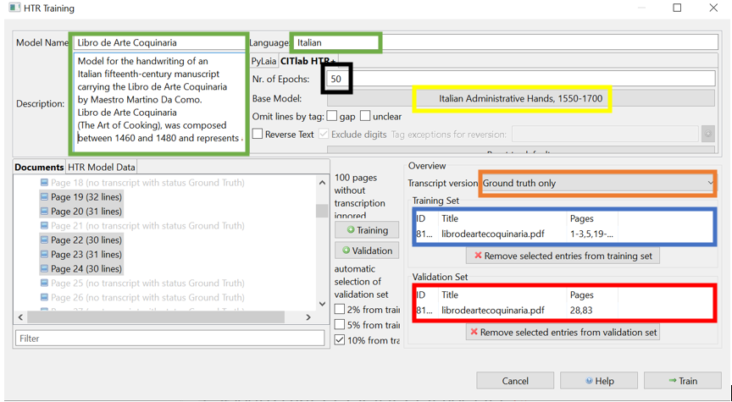
90%
10%

Slide 16
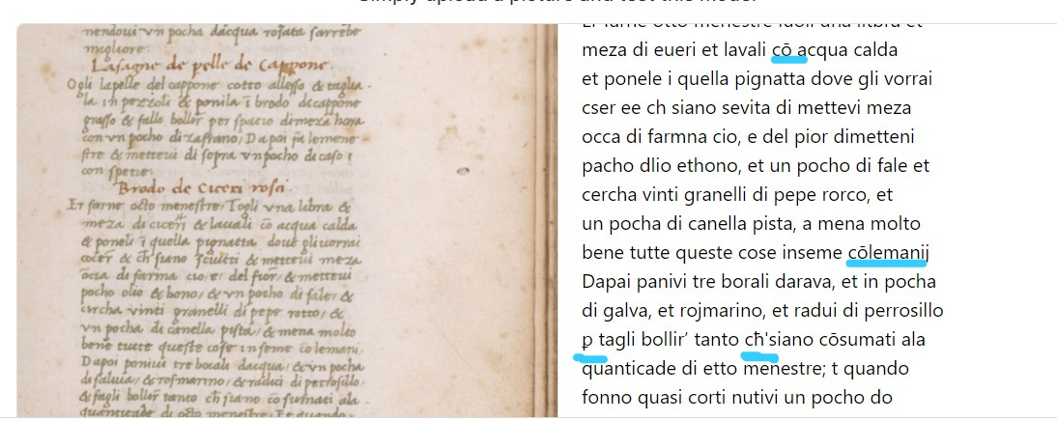
Training with a base model: Italian Administrative Hands 1550-1700
The only HTR public model specifically trained on Italian
based on some humanistic hands,
proved sufficiently good when tested on a page of the Libro de Arte Coquinaria.
Output of the test performed on a page of the Libro de Arte Coquinaria, in blue the abbreviations detected.

Slide 17
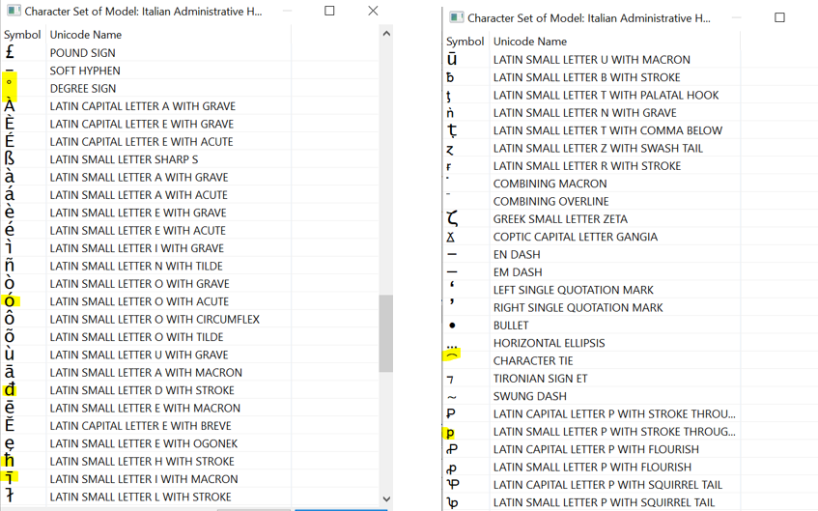
Base model's character set, in yellow the characters also found in the manuscript.

Slide 18



examined their learning curve
analysed the model’s errors with respect to our Ground Truth
1
3
2
4
interpreted the Character Error Rate (CER)
compared the two models by testing them on the same page

Slide 19
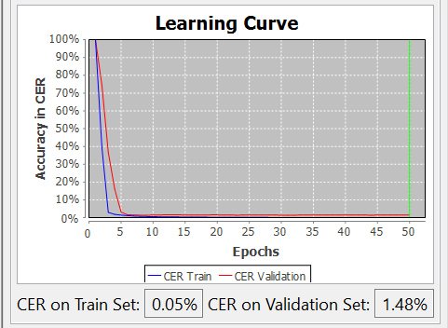
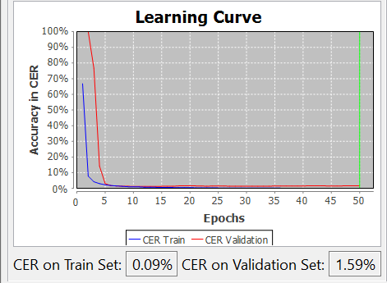
Learning curve
Accuracy on the validation set
Accuracy on the training set
CER: 1,48%
CER: 1,59%
Learning curve of the model created from the base model
Learning curve of the model created from scatch.

Slide 20

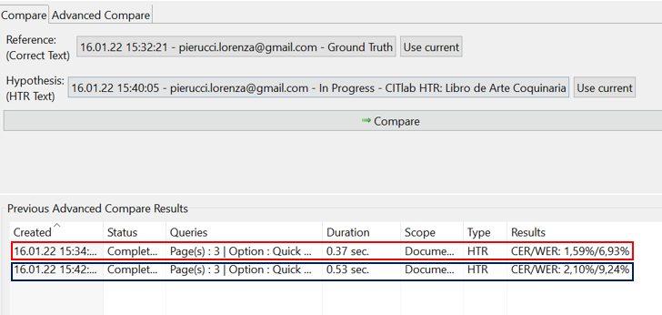
Model with base:
CER/WER
1,59%/6,93%
Model without base:
CER/WER
2,10%/9,24%
Reference : manually transcribed page (GT)
Hypothesis: same page transcribed by the models.

Slide 21

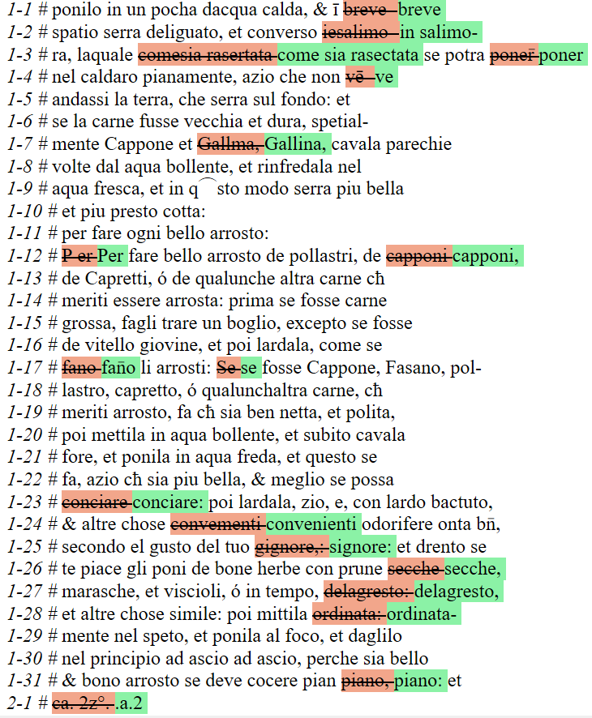
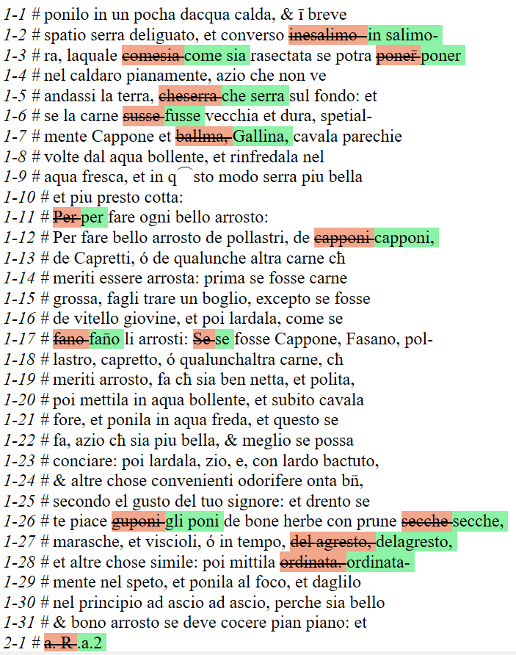
GT
Errors of the transcriptions of the models
The errors of the transcription of the model created from scratch..
The errors of the transcription of the model with the base..

Slide 22
Export

Slide 23
Conclusion

Slide 24
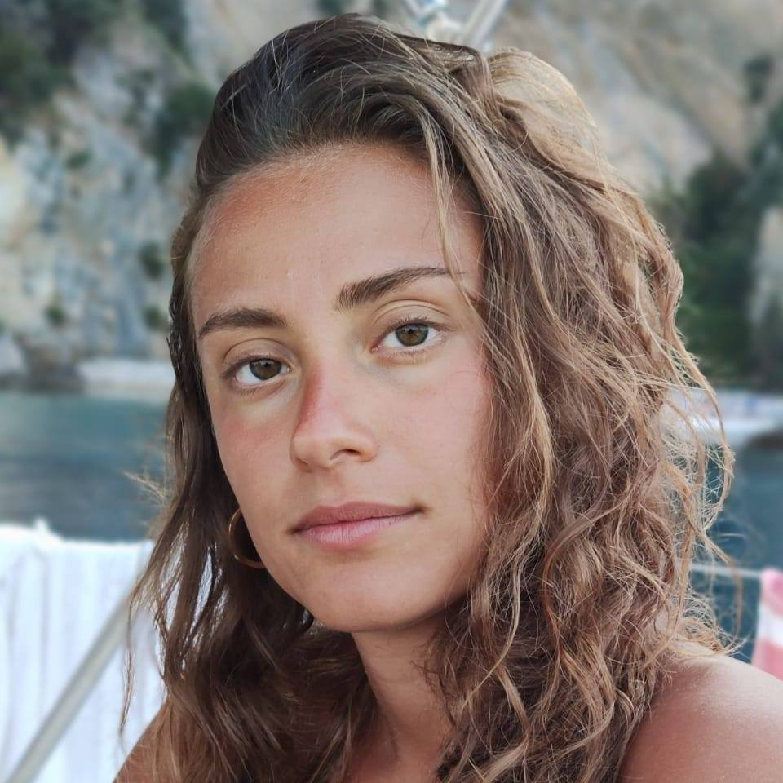
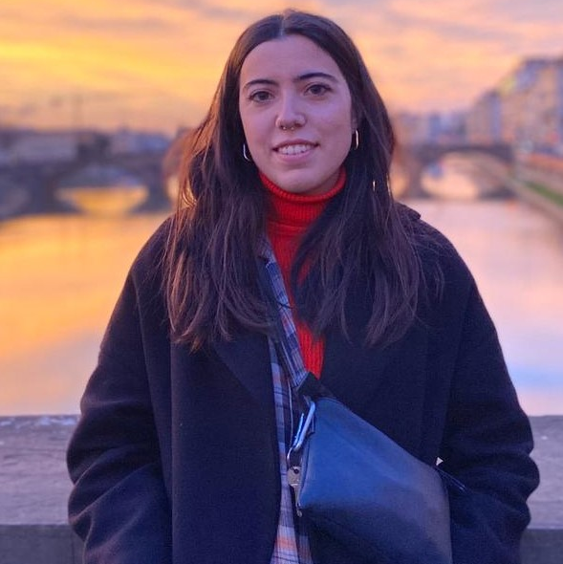
Our Team
Francesca Borriello
francesca.borriello@studio.unibo.it
Constance Dami
constance.dami@studio.unibo.it
Lorenza Pierucci
lorenza.pierucci@studio.unibo.it

Slide 25
Thanks
for the attention!

